Slide 1
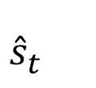
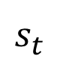
Network Operator
Forecast Representation
Controller
Trainable Control Module
(Uses External Forecast)
$$a_{t}^{C}$$
$$s_{t}^{}$$
$${{\hat{s}}_{t}^{}}_{}^{}$$
+
+
Pre-trained, Modular Controller
Task Feedback: $\frac{∂r_{t}^{c}}{∂φ_{t}^{F}}$
Observer
Internal State $s_{t}^{F}$
Controller
Internal State
Controller
Full State
$$x_{t}^{C}$$
$$s_{t}^{C}=[x_{t}^{C}, φ_{t}^{F}]$$

Slide 2


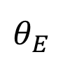
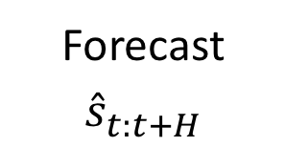

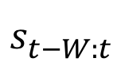

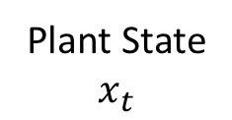
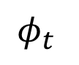
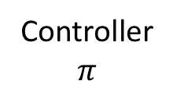
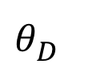
Timeseries Generator
Control System
Encoder
Decoder
$$φ_{t}$$
$$s_{t−W:t}^{}$$
Forecast${\hat{s}}_{t:t+H}^{}$
Cost $J$
$$θ_{E}^{}$$
$$θ_{D}^{}$$
Controller
$π$
Plant State
$x_{t}$
Control $u_{t}$

